Slide 1



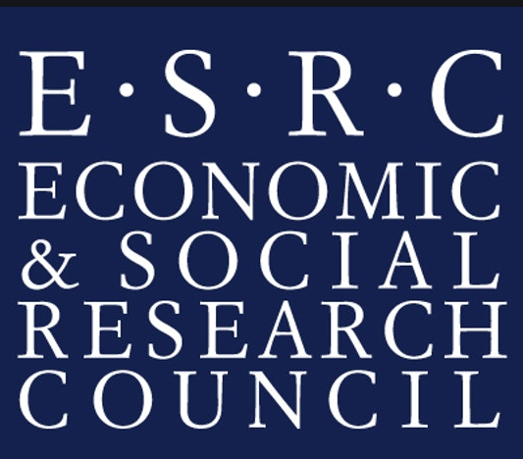

Political Polarisation and Othering:
Modelling the polarisation of the Catalan secessionist movement on social media
Cristina Chueca Del Cerro
PhD candidate, University of Glasgow
Lorentz workshop on Othering & Polarisation (online)
10/06/2020

Slide 2
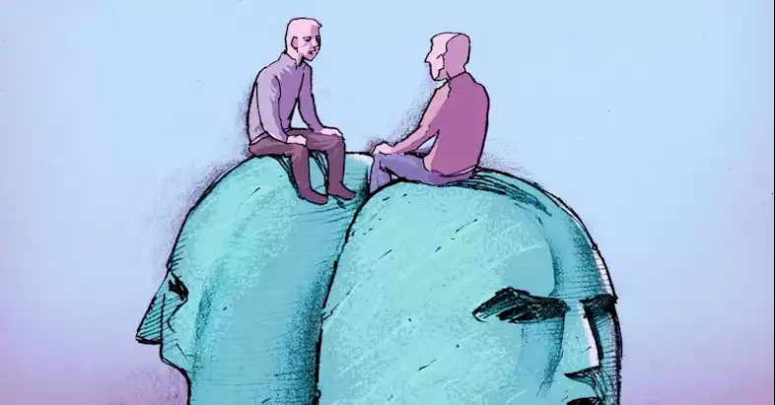
Opinion Polarisation
Opinion polarisation can be used to describe a process and a state (Di Maggio et al, 1996:693).
  A state: Opposed opinions in relation to some theoretical maximum
  A process: Changes of opposed opinions about an issue (increased variance) over time

Slide 3
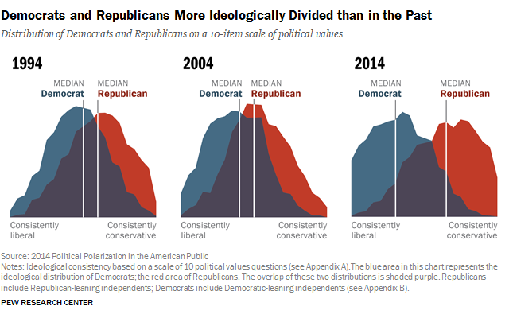
Measuring Polarisation
Ideological polarisation can be measured in different ways (Lelkes, 2016):
  Ideological consistency: Comparing the group mean differences in political ideology self-identification against different policy and social issues (Abramowitz and Saunders, 2008; McCarty, et al., 2006)
  Ideological divergence: Ideological self-placement responses distribution, bimodal distrib. (two peaks or more) or degree of distrib. overlap (Fiorina and Levenduski, 2008; Baldassari and Gelman, 2008)

Slide 4

Othering
Individuals develop group identities with social norms and opinions.
These identities are based on differentiating themselves (in group) from ‘others’ (out group) (Tajfel and Turner, 1979; Turner et al., 1986).
Negative consequences: discrimination, incivility, radicalisation of opinions

Slide 5
My Research – Secessionist movements & Polarisation
Secessionist movements are an example of polarisation and othering
Goal to understand:
  The relationship between polarised nationalism and othering as a contributor to political conflict in secessionist movements
  The processes that lead to the polarisation of secessionism discussions on social media

Slide 6
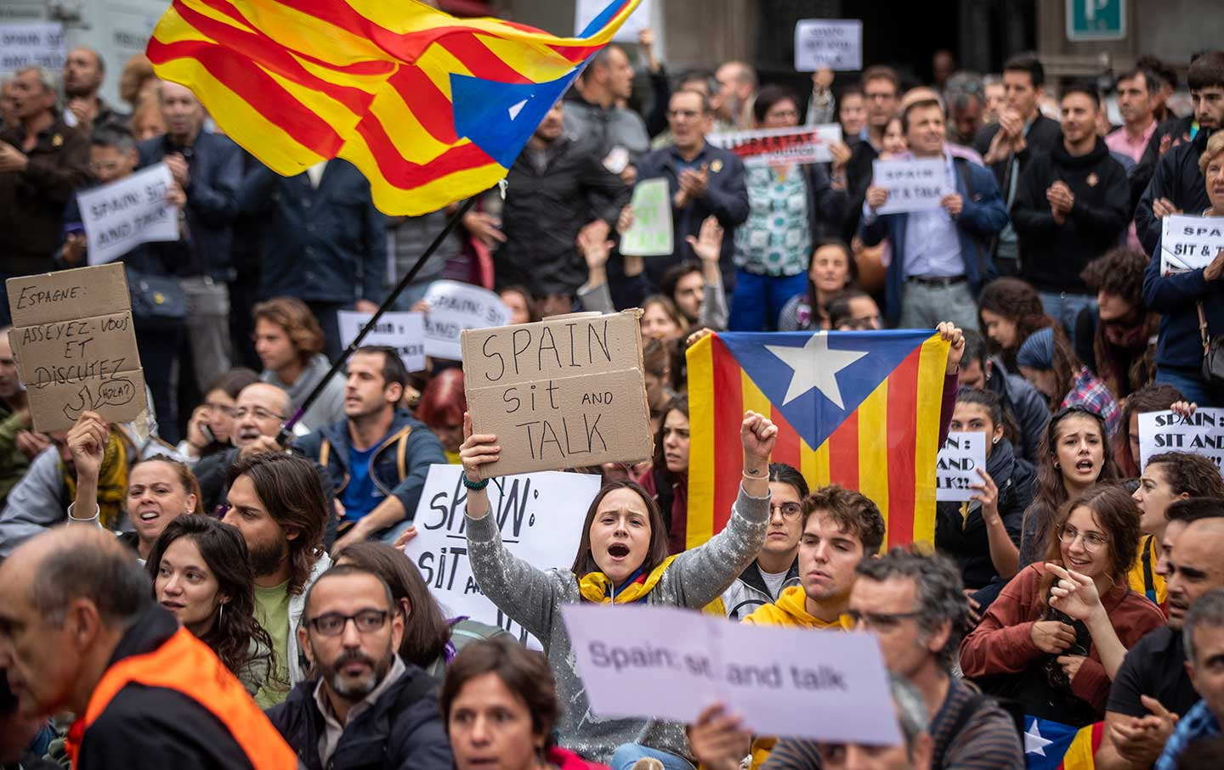
My Research – Secessionist movements & Polarisation
Where: Catalonia, Spain
  Ongoing movement
  Polarising society (nationalism)
  Intergroup political conflict

Slide 7
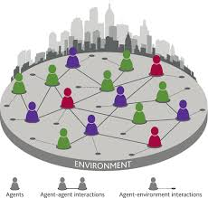


My Research – Secessionist movements & Polarisation
How: Agent-based model (ABM) of opinion polarisation in secessionist movements on social media platforms (see Flache et al., 2017; Mathias et al., 2018)
Calibration and validation - real-world data
from Twitter and Facebook discussions of
Catalonia’s independence

Slide 8

Email: c.chueca-del-cerro.1@research.gla.ac.uk @ChuecaCristina

Slide 9
References
Abramowitz, A.I., and Saunders, K.L. (2008) Is Polarization a Myth?, The Journal of Politics, Vol. 70(2), pp. 542-555
Baldassari, D., and Gelman, A. (2008) Partisans without Constraint: Political Polarization and Trends in American Public Opinion, American Journal of Sociology, Vol. 114(2), pp.408–46
Di Maggio, P., Evans, J., & Bryson, B. (1996). Have American's Social Attitudes Become More Polarized? American Journal of Sociology, Vol. 102(3), pp. 690-75
Fiorina, M. and Levendusky, M.S. (2006) “Disconnected: The Political Class versus the People—Rejoinder.” In Red and Blue Nation? Volume I: Characteristics and Causes of America’s Polarized Politics, edited by Pietro S. Nivola and David W. Brady , 95 – 110 . Washington, DC : Brookings Institution Press ; and Stanford, CA : Hoover Institution Press
Flache, A., Michael Mäs, M., Feliciani, T., Chattoe-Brown, E., Deffuant, G., Huet, S., and Lorenz, J. (2017) Models of Social Influence: Towards the Next Frontiers, Journal of Artificial Societies and Social Simulation, Vol. 20(4), pp.1-31
Lelkes, Y. (2016) Mass Polarization: Manifestations and Measurements, Public Opinion Quarterly, Vol. 80(S1), pp. 392–410
Mathias, JD., Huet, S., and Deffuant, G. (2016) Bounded Confidence Model with Fixed Uncertainties and Extremists: The Opinions Can Keep Fluctuating Indefinitely, Journal of Artificial Societies and Social Simulation, Vol. 19(1), pp.1-15
McCarty, N., Poole, K.T., and Rosenthal, H. (2006) Polarized America: The Dance of Ideology and Unequal Riches, Cambridge: MIT
Tajfel, H. (1978) Differentiation between Social Groups: Studies in the Social Psychology of Intergroup Relations, London: Academic
Turner, J.C., Hogg, M.A., Oakes, P.J., Reicher, S.D., and Wetherell, M.S. (1987) Rediscovering the social group. A self-categorization theory. Blackwell: Oxford

