Slide 1
Questions about the nature and observation of Polarization
Kevin Durrheim
University of KwaZulu-Natal
Notes:
How do we know its polarization? Questions before modelling
Brexit debate in the UK; Land expropriation in South Africa; Bipartisan structure of debate over healthcare or abortion in the USA

Slide 2
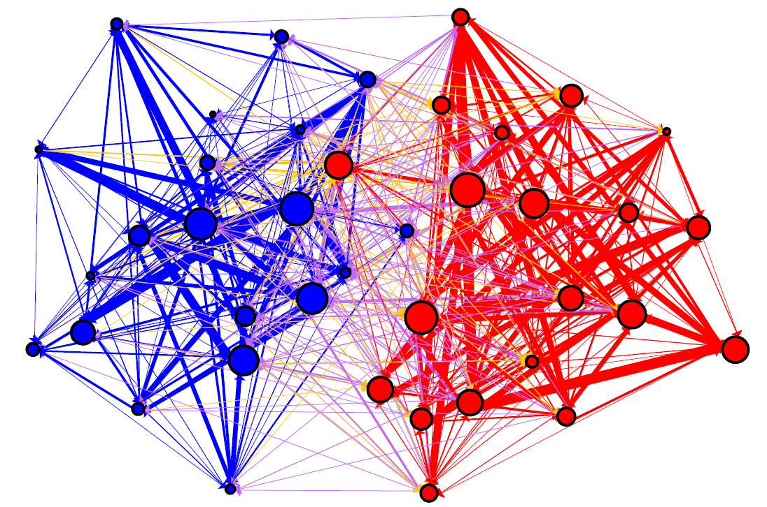
What is polarization?
Group opinion dynamic – “risky shift”
Identity dynamic – “positive distinctiveness”
Network dynamic – segregation
Political dynamic – radicalization
Adamic, L., & Glance, N. (2005). The Political Blogosphere and the 2004 U.S. Election: Divided They Blog. in Proceedings of LinkKDD.

Slide 3
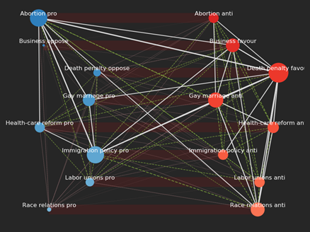
What is polarization?
Group opinion dynamic – “risky shift”
Identity dynamic – “positive distinctiveness”
Network dynamic – segregation
Political dynamic – radicalization
Bipartite graph of American National Election Survey data (2012), with Republicans in red and Democrats in Blue.

Slide 4
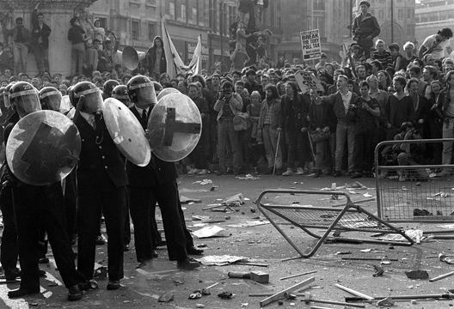
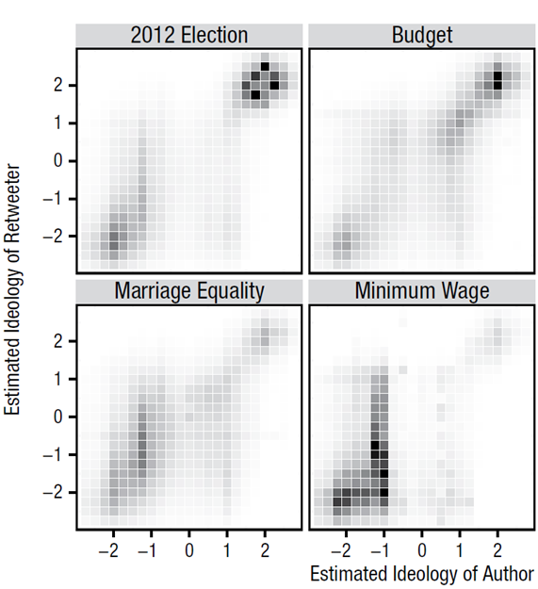
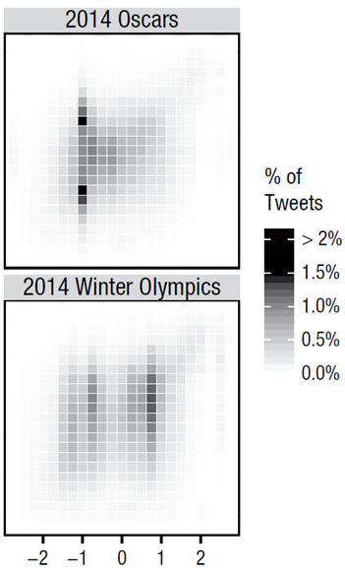
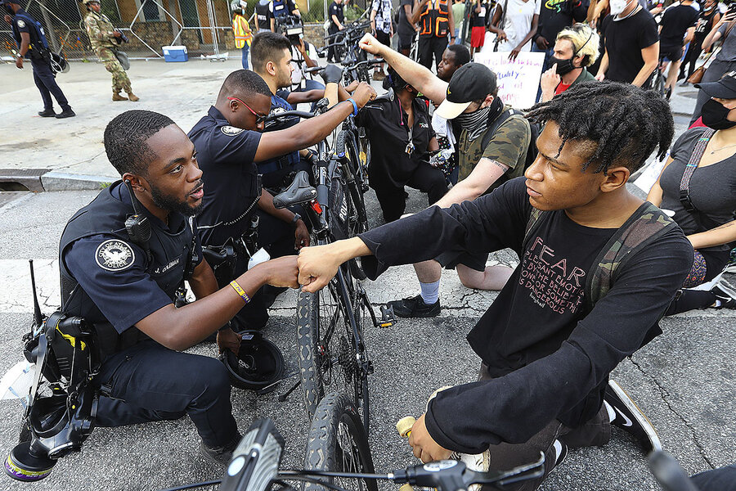
Polarization is dynamic
Barberá, P., Jost, J.T., Nagler, J., Tucker, J.A., & Bonneau, R. (2015). Tweeting From Left to Right: Is Online Political Communication More Than an Echo Chamber? Psychological Science, 26, 1531–1542.
Steve Reicher, John Drury and Clifford Stott

Slide 5
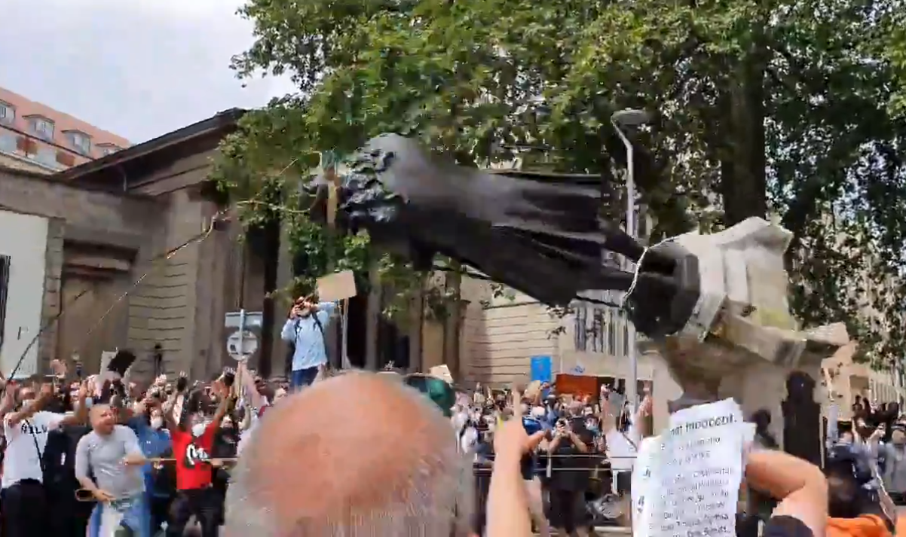
In a Monmouth University poll released this week, 76 percent of Americans — including 71 percent of white people — called racism and discrimination “a big problem” in the United States. That’s a 26-percentage-point spike since 2015.
Social Change
Notes:
https://www.nytimes.com/2020/06/05/us/politics/polling-george-floyd-protests-racism.html

Slide 6
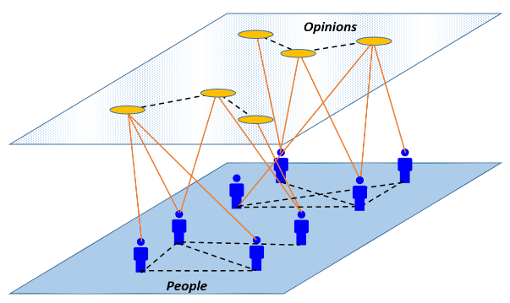
What is polarization?
Bipartite network of people and opinions
The moment of a part of a dynamic process
MacCarron P, Maher PJ, Fennell S, Burke K, Gleeson JP, Durrheim K, Quayle, M. (2020). Agreement threshold on Axelrod’s model of cultural dissemination. PLoS ONE 15(6):
Notes:
Tectonic plates metaphor

